Slide 1

Turbulence Modelling for Smoothed Particle Hydrodynamics
K T Prajwal Prathiksh
Dual Degree Project (Stage I) - Presentation
Supervisor: Prof. Prabhu Ramachandran
Department of Aerospace Engineering
Indian Institute of Technology Bombay
October 25th, 2022
Notes:
Buy Aeroelasticity (Dover Books on Aeronautical Engineering) Book Online at Low Prices in India | Aeroelasticity (Dover Books on Aeronautical Engineering) Reviews & Ratings
Merging Radius between two vortices
Summarize the russian paper
Sine wave/Saw tooth wave/Squre wave - heaving motion for the cylinder

Slide 2
Introduction
Turbulent Flow
Characterization
High Reynolds number flows
Random spatial & temporal velocity fluctuations
Rotational & 3D velocity field
Large mixing capacity of the flow
Chaotic nature of solutions
Modelling
Lacks analytical solutions except for simple cases
CFD simulations required for complex flows
Typical modelling techniques
Governing equations → Averaged or filtered
Closure problem → Fluctuating components modelled using mean flow properties
Stochastic methods
Models mostly based on Eulerian framework
Lagrangian Modelling – SPH
No background mesh
Handles large deformations, complex boundary dynamics
Simplified model implementation
Highly & efficiently parallelizable

Slide 3
Project Objectives
Turbulence Modelling in SPH
Lacks robust & accurate models
Shortcomings of current models:
Cannot be generalized to various types of turbulence-based problems
Issues in scaling to 3D turbulent flows
Accuracy & computational constraints
Boundary conditions & treatment not well established
Project Objective
Review state of the art turbulence models in SPH
Provide advantages & disadvantages of the major categories of models
Extend promising models to robust & accurate SPH schemes^{[1]}
Analyze & study its performance in bounded turbulent flow
Improve overall scheme using recent developments of SPH
Existing
Models
Expected
Outcome
[1] P. Negi and P. Ramachandran, “How to train your solver: A method of manufactured solutions for weakly compressible smoothed particle hydrodynamics,” Phys. Fluids, vol. 33, no. 12, 2021, doi: 10.1063/5.0072383.

Slide 4
Project’s Progress
Surveyed research papers detailing work on turbulence models for SPH (c. 2000 – 2022)
Classified 5 major categories of turbulence models
Identified a systematic, model-evaluation method
Benchmark problems feasible with SPH
Post-simulation analysis techniques
Turbulence Modelling
Turbulence Models
Viscosity
LES
Lagrangian-LES
RANS
LANS
Artificial
Stochastic
Implicit P-Poisson
Explicit P-EOS

Slide 5
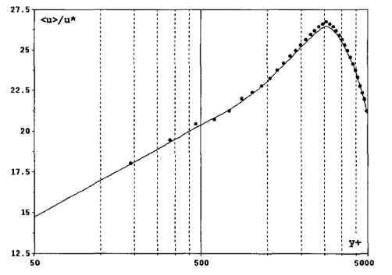
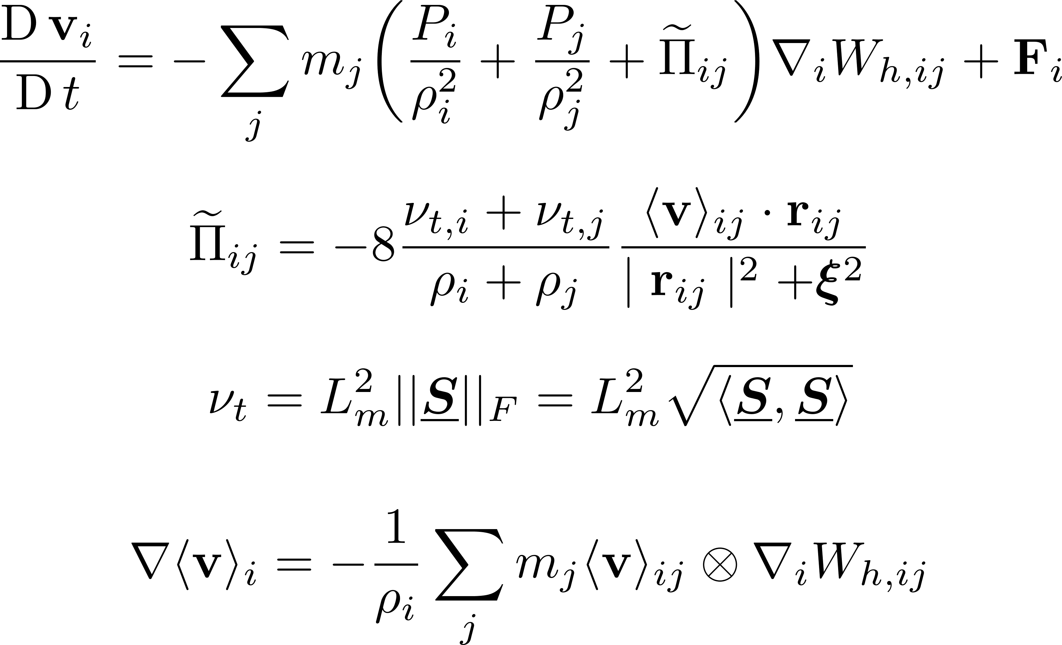

Viscosity-based Models
Eddy Viscosity Model^{[1]}
One of the first classes of SPH turbulence models
Velocities are Reynolds-averaged
First-order closure model:
Reynolds stress tensor & mean velocity gradients
Turbulent eddy viscosity considered
Simulated Poiseuille flow $(Re = 6.4×{10}^{4})$
Comments
Reproduced log-law profile near walls
Appropriate for shear flows
Fig: Computed mean velocity profile of turbulent Poiseuille flow in a pipe (Rep: Violeau et al)
[1] D. VIOLEAU, S. PICCON, and J.-P. CHABARD, “TWO ATTEMPTS OF TURBULENCE MODELLING IN SMOOTHED PARTICLE HYDRODYNAMICS,” in Advances in Fluid Modeling and Turbulence Measurements, Jul. 2002, vol. 1, no. 5, pp. 339–346, doi: 10.1142/9789812777591_0041.

Slide 6
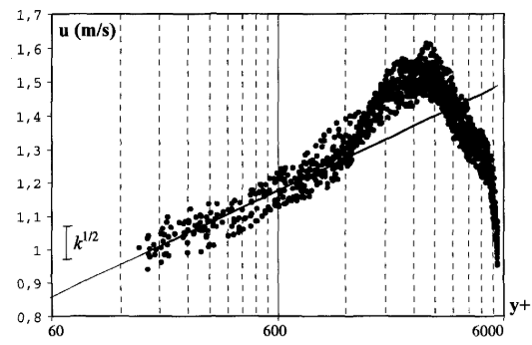
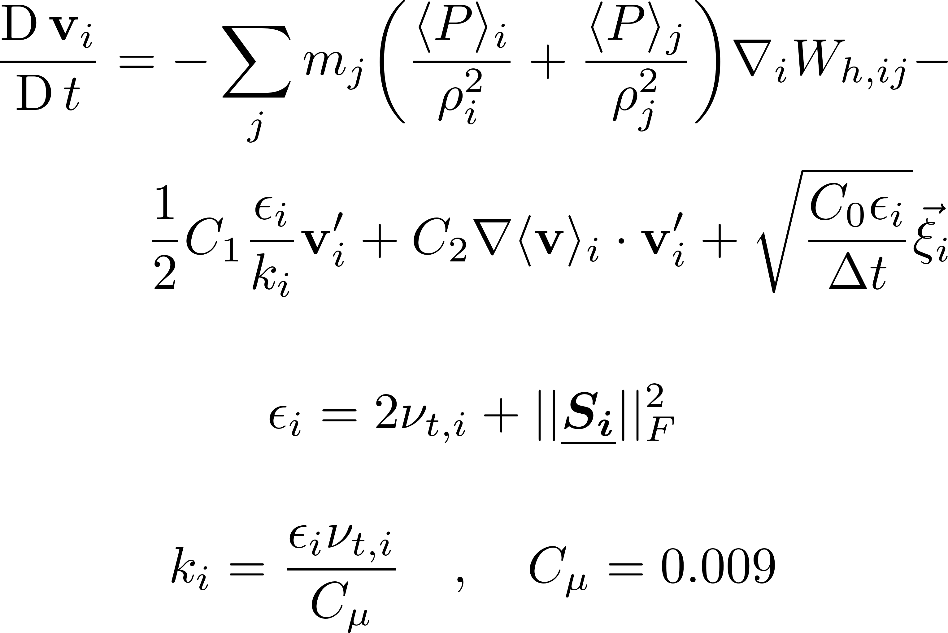

Viscosity-based Models
Generalized Langevin Model^{[1]}
Prescribed the particle velocity as a random process
Acceleration → Function of a random vector (non-correlated with velocity)
Simulated Poiseuille flow $(Re = 6.4×{10}^{4})$
Comments
Mean operator appeared to behave like a LES filter
Large deviations observed in mean velocity profile $(∝k^{0.5})$
Can be generalized to various types of turbulent flows, & not only shear flows
Fig: Computed mean velocity profile of turbulent Poiseuille flow in a pipe (Rep: Violeau et al)
[1] D. VIOLEAU, S. PICCON, and J.-P. CHABARD, “TWO ATTEMPTS OF TURBULENCE MODELLING IN SMOOTHED PARTICLE HYDRODYNAMICS,” in Advances in Fluid Modeling and Turbulence Measurements, Jul. 2002, vol. 1, no. 5, pp. 339–346, doi: 10.1142/9789812777591_0041.

Slide 7
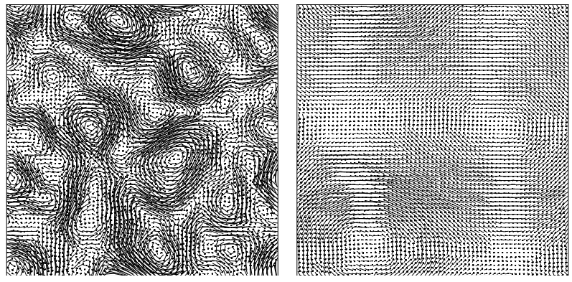

Viscosity-based Models
Modified-SPH (mSPH)^{[1]}
Observation: Absence of viscosity → Noisy particle motion
Finite viscosity → Over-prediction of dissipation
Modified EOS & MOM eqs. → Particle distribution homogenised
Simulated:
2D Taylor-Green Vortex (TGV) $\left(Re =∞, N_{i}={64}^{2}\right)$
3D Taylor-Green Vortex (TGV) $\left(Re =400, N_{i}={64}^{3}\right)$
Comments
Merging of vortices observed
Energy cascade (Kolmogorv scale) slopes reproduced
mSPH (-3); standard SPH (1)
Transitional flow simulated with reasonable dissipation rate
mSPH $∼$ Eddy viscosity model below numerical resolution
Fig: Velocity vector plot at t=2 (left) and t=30 (right). (Rep: Adami et al)
[1] S. Adami, X. Y. Hu, and N. A. Adams, “Simulating three-dimensional turbulence with SPH,” 2012.

Slide 8
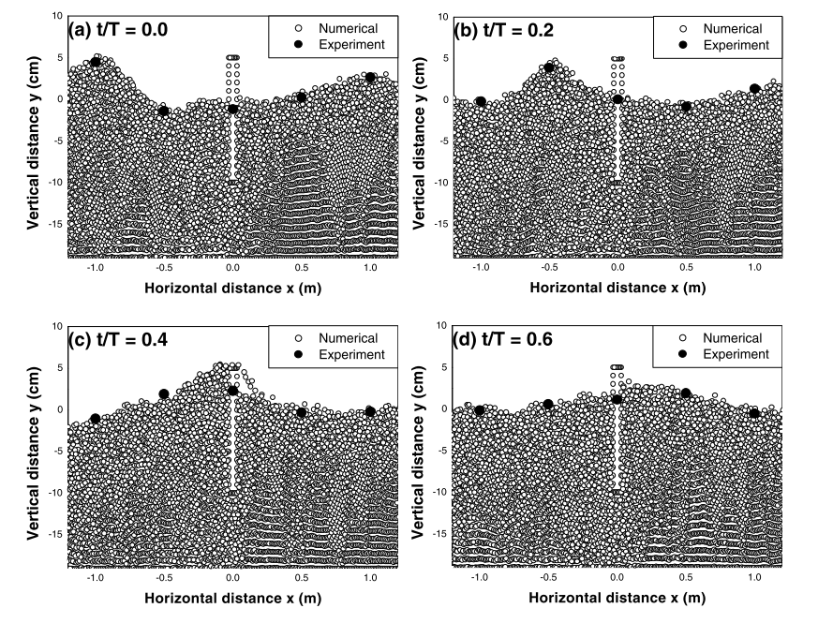
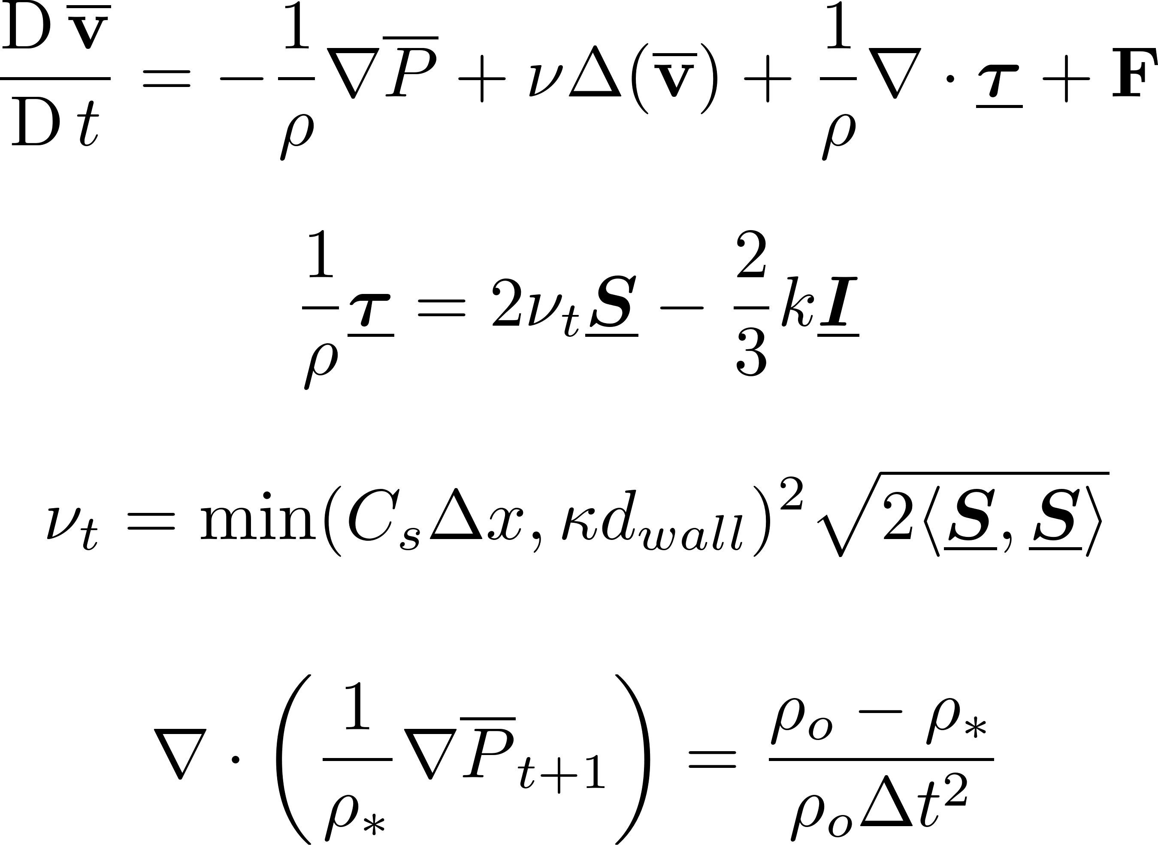
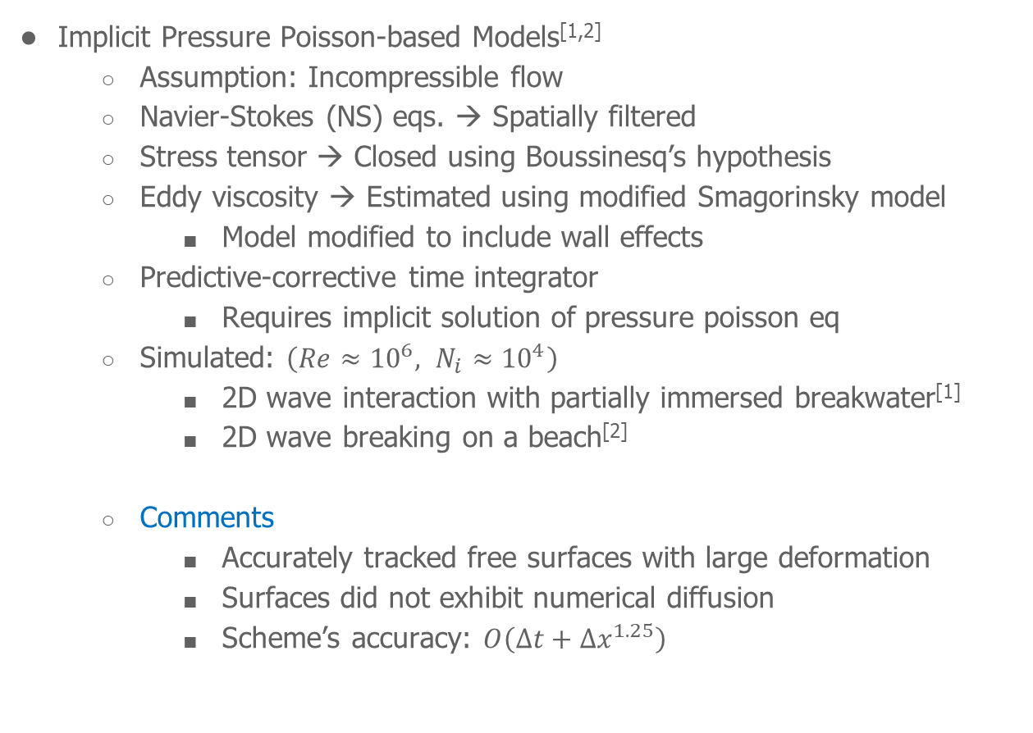
Large-Eddy Simulation-based Models
Implicit Pressure Poisson-based Models^{[1,2]}
Assumption: Incompressible flow
Navier-Stokes (NS) eqs. → Spatially filtered
Stress tensor → Closed using Boussinesq’s hypothesis
Eddy viscosity → Estimated using modified Smagorinsky model
Model modified to include wall effects
Predictive-corrective time integrator
Requires implicit solution of pressure poisson eq
Simulated: $\left(Re≈{10}^{6}, N_{i}≈{10}^{4}\right)$
2D wave interaction with partially immersed breakwater^{[1]}
2D wave breaking on a beach^{[2]}
Comments
Accurately tracked free surfaces with large deformation
Surfaces did not exhibit numerical diffusion
Scheme’s accuracy: $O\left(Δt+Δx^{1.25}\right)$
Fig: Time sequences of wave profile. (Rep: Gotoh et al)
[1] H. Gotoh, S. Shao, and T. Memita, “SPH-LES model for numerical investigation of wave interaction with partially immersed breakwater,” Coast. Eng. J., vol. 46, no. 1, pp. 39–63, 2004, doi: 10.1142/S0578563404000872.
[2] S. Shao and H. Gotoh, “Turbulence particle models for tracking free surfaces,” J. Hydraul. Res., vol. 43, no. 3, pp. 276–289, May 2005, doi: 10.1080/00221680509500122.
Notes:
Model is modified to include wall effects, s.t., it is not over-dissipative inside laminar layer

Slide 9
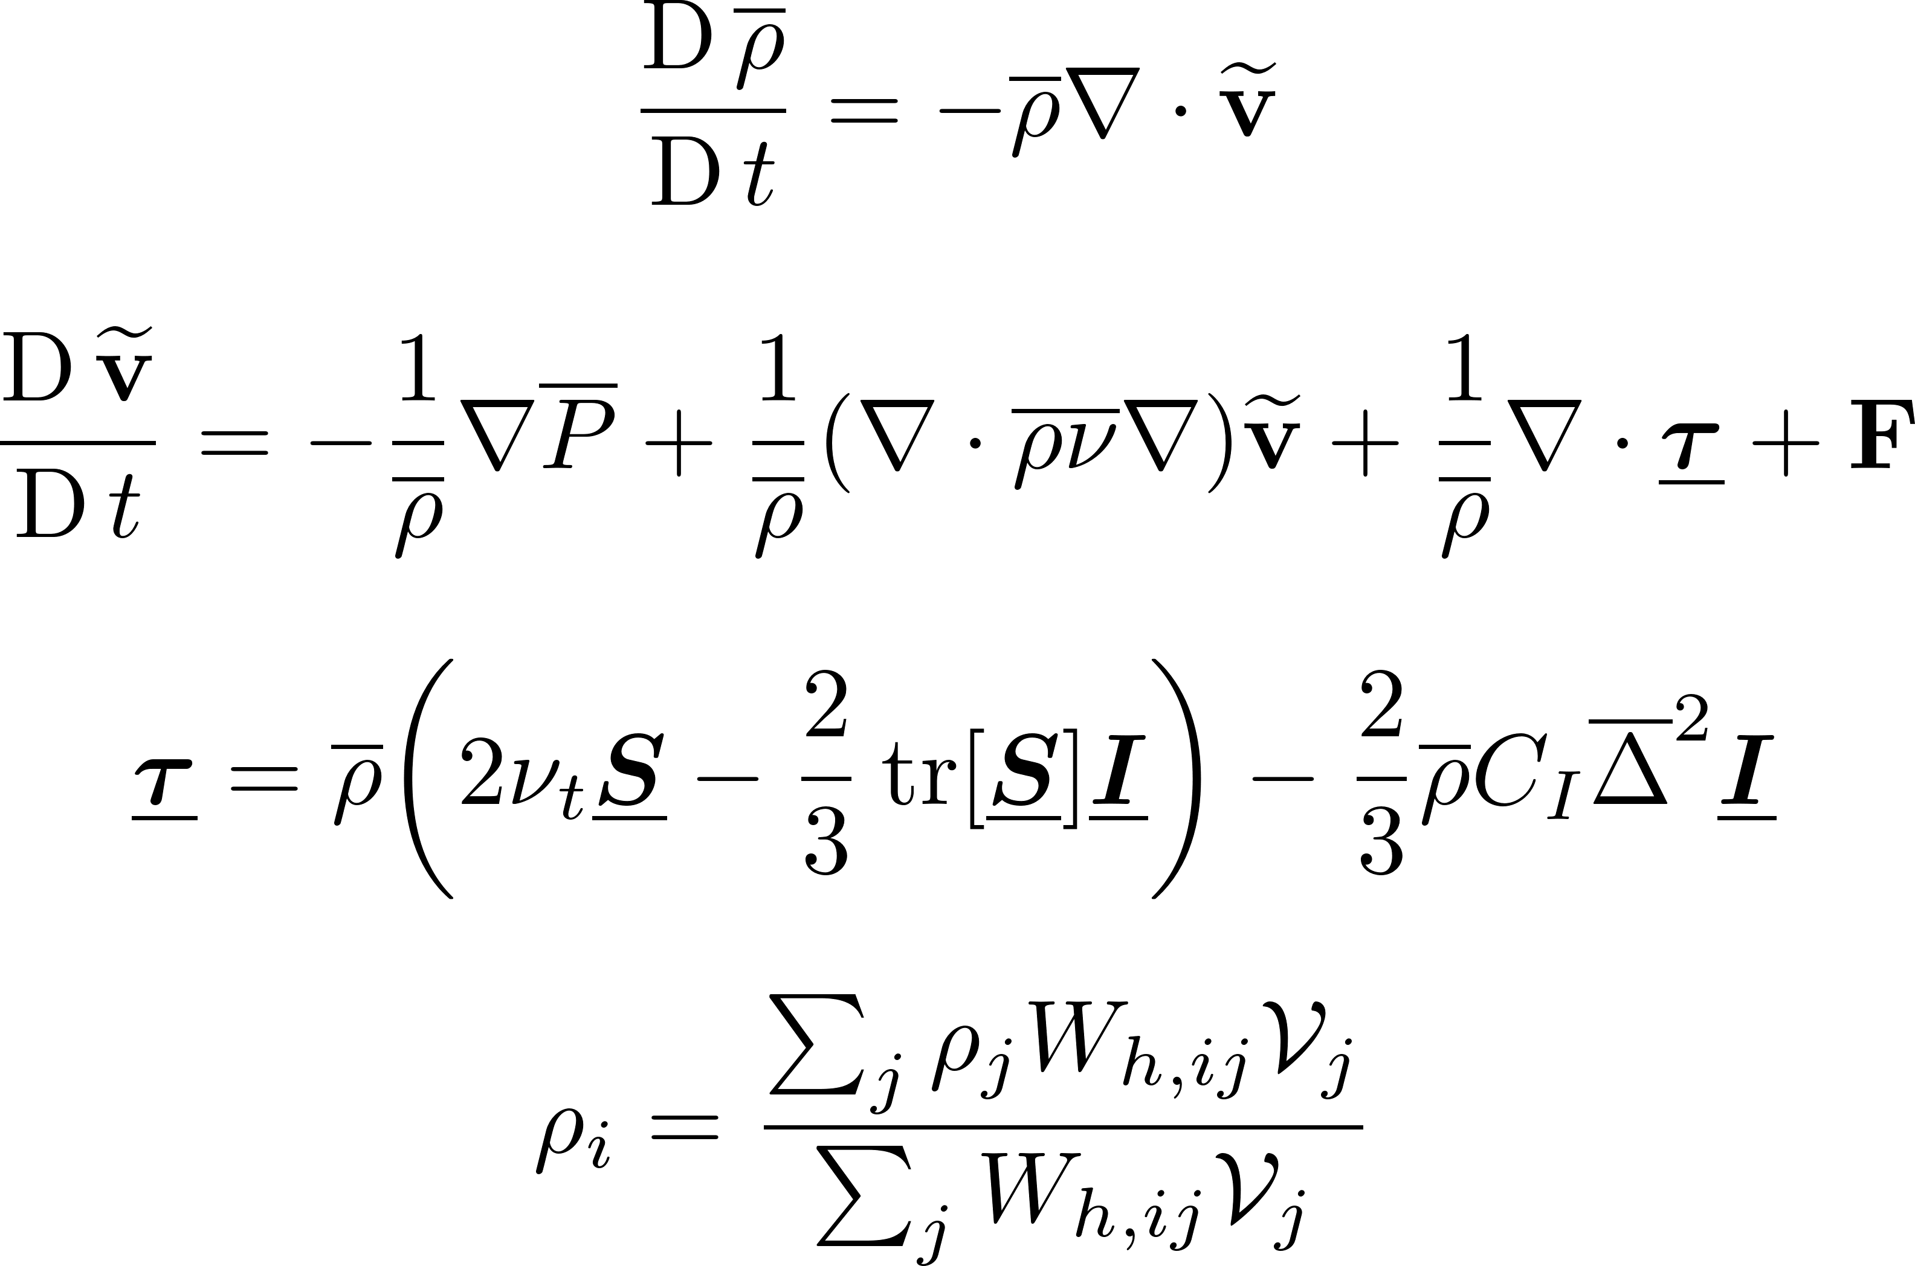

Large-Eddy Simulation-based Models
Explicit Pressure EOS-based Models^{[1,2]}
Assumption: Compressible flow
NS eqs → Favre averaged
Observation: Density variations → Unphysical behaviour on free surfaces
Shepard filtering of density performed periodically
Simulated: $\left(Re≈{10}^{6}, N_{i}≈{10}^{4}\right)$
Weakly plunging breaker in 2D & 3D^{[1]}
2D green-water overtopping, 2D & 3D wave breaking, 3D dam break^{[2]}
Comments
Model predicted regions of high vorticity in 2D
Model captured vertically oriented eddies in 3D
Accurate for flow separation or splash-based problems
Requires large $N_{i}$ & very small $Δt$
Uncertain regarding scalability to large-scale problems
[1] B. D. ROGERS and R. A. DALRYMPLE, “SPH MODELING OF BREAKING WAVES,” in Coastal Engineering 2004, Apr. 2005, pp. 415–427, doi: 10.1142/9789812701916_0032.
[2] R. A. Dalrymple and B. D. Rogers, “Numerical modeling of water waves with the SPH method,” vol. 53, pp. 141–147, 2006, doi: 10.1016/j.coastaleng.2005.10.004.

Slide 10
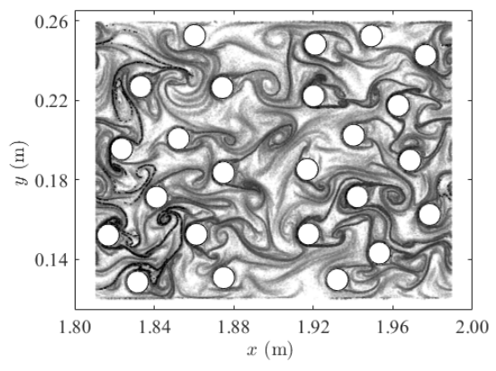
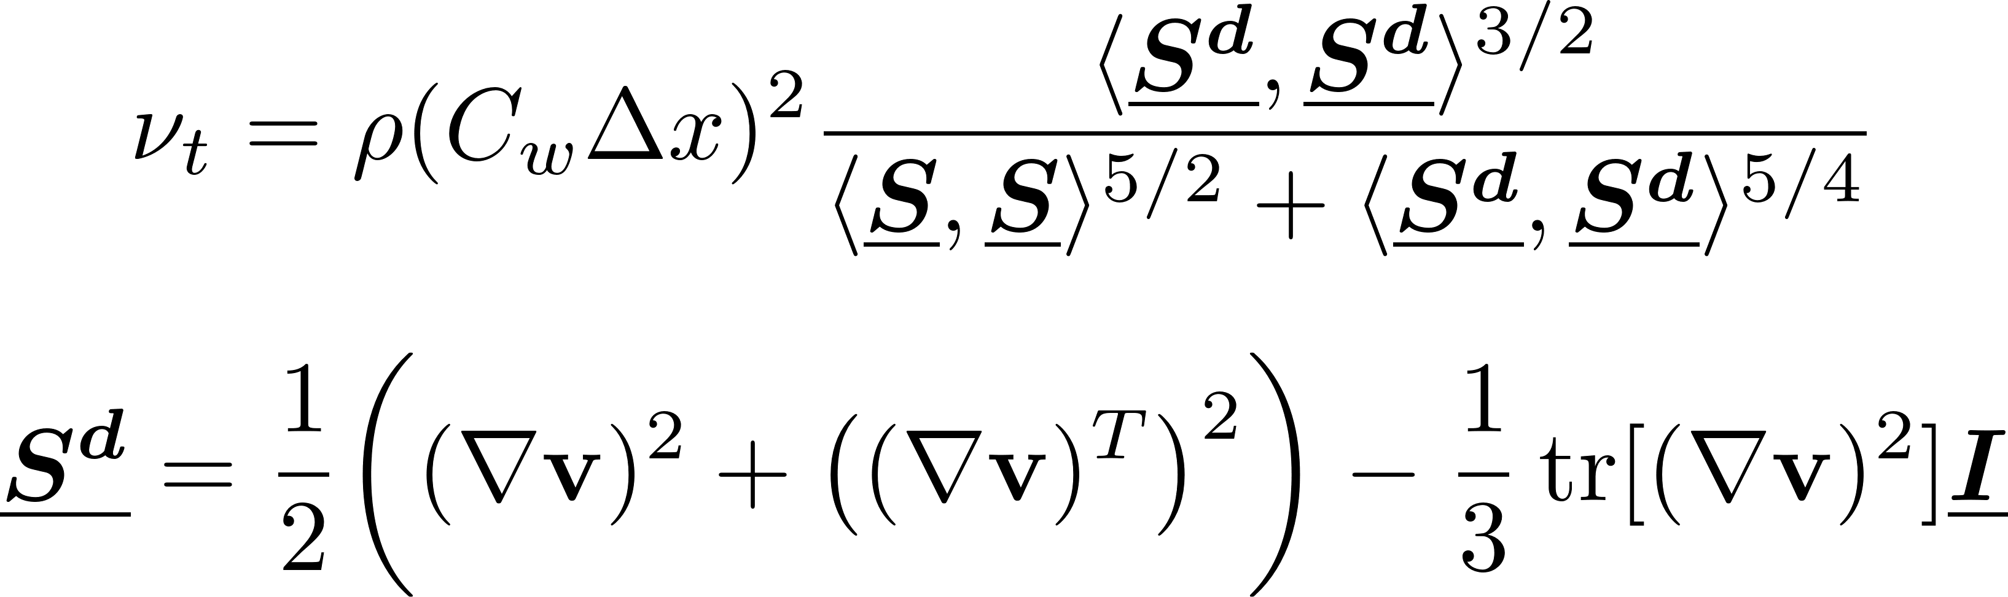

Large-Eddy Simulation-based Models
Explicit Pressure EOS-based Models^{[1]}
Observation: Standard Smagorinsky model cannot enforce
Wall conditions
Non-vanishing stresses with laminar flows
Devised Wall-adapting local eddy viscosity model (WALE)
Simulated an array of cylinders in 2D flow $\left(Re≈{10}^{2}, N_{i}≈{10}^{4}\right)$
Comments
LCS captured reasonably well
Observed merging of vortices to larger structures
Interactions of vortices with opposing strengths → Vorticity cancellation
Claim: Complex vortex interactions → Possible difficulty in interpreting the energy spectrum
Fig: Backward-in-time FTLE field. (Rep: Canelas et al)
[1] R. B. Canelas, A. M. Ricardo, R. M. L. Ferreira, J. M. Domínguez, and A. J. C. Crespo, “Hunting for Lagrangian Coherent Structures : SPH-LES turbulence simulations with Wall-adapting Local Eddy Viscosity ( WALE ) model,” 11th SPHERIC, no. March 2017, 2016, [Online].

Slide 11
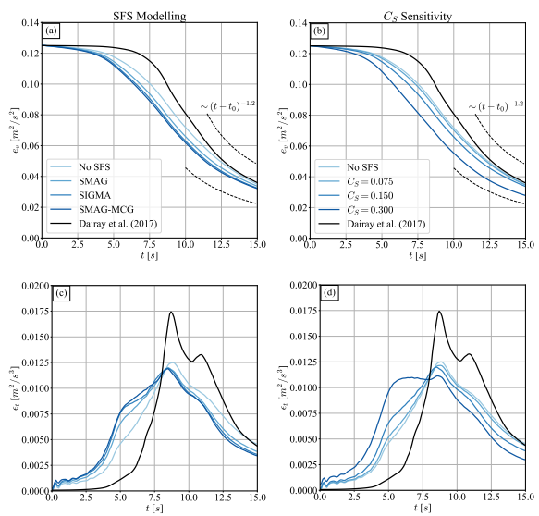

Large-Eddy Simulation-based Models
Explicit Pressure EOS-based Models^{[1]}
Reinterpret SPH → Lagrangian quadrature technique for explicit LES
Kernel scale limits SPH’s physical resolution → Unsuitable DNS alternative
Navier-Stokes (NS) eqs. → Spatially filtered
Compared multiple Smagorinsky models
(standard, $σ$, MCG-form)
Simulated 3D TGV $\left(Re≈{10}^{4}, N_{i}={200}^{3}−{500}^{3}\right)$
Comments
Smagorisnky models reduced averaged kinetic energy
Dissipation rates not predicted accurately
SPH can capture turbulence up to kernel scale (high cost)
Explicit SGS models remove kinetic energy → Increases energy deficit of standard SPH
“SGS models in SPH framework only degrade the quality of the subsonic turbulent flow approximation”^{[2]}
Fig: Density-weighted averaged kinetic energy (top), averaged dissipation rate (bottom). (Rep: Okraschevski et al)
[1] M. Okraschevski, N. Bürkle, R. Koch, and H.-J. Bauer, “Smoothed Particle Hydrodynamics Physically Reconsidered -- The Relation to Explicit Large Eddy Simulation and the Issue of Particle Duality,” 2022, [Online].
[2] D. Rennehan, “Mixing matters,” Mon. Not. R. Astron. Soc., vol. 506, no. 2, pp. 2836–2852, 2021.

Slide 12
Lagrangian LES-based Models
[1] Dynnikova, G. Ya et al. (2021). “Stability of a reverse Karman vortex street”. In: Physics of Fluids 33.2. ISSN: 10897666. DOI: 10.1063/5.0035575.

Slide 13
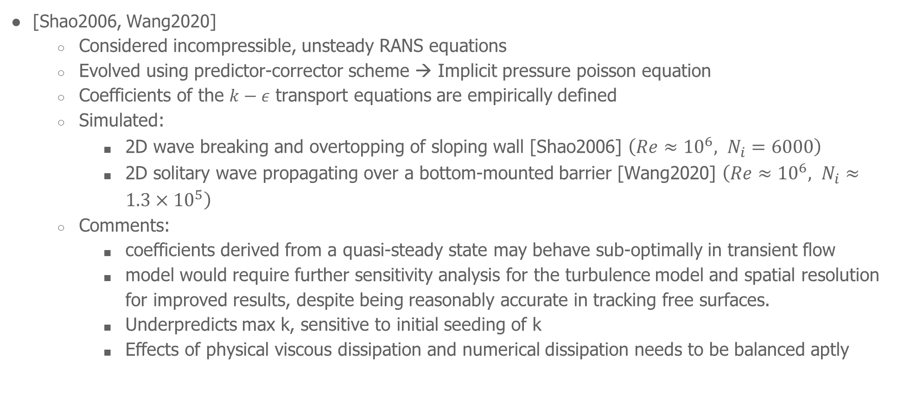
RANS-based $k−ε$ Models
[Shao2006, Wang2020]
Considered incompressible, unsteady RANS equations
Evolved using predictor-corrector scheme → Implicit pressure poisson equation
Coefficients of the $k−ε$ transport equations are empirically defined
Simulated:
2D wave breaking and overtopping of sloping wall [Shao2006] $\left(Re≈{10}^{6}, N_{i}=6000\right)$
2D solitary wave propagating over a bottom-mounted barrier [Wang2020] $\left(Re≈{10}^{6}, N_{i}≈1.3×{10}^{5}\right)$
Comments:
coefficients derived from a quasi-steady state may behave sub-optimally in transient flow
model would require further sensitivity analysis for the turbulence model and spatial resolution for improved results, despite being reasonably accurate in tracking free surfaces.
Underpredicts max k, sensitive to initial seeding of k
Effects of physical viscous dissipation and numerical dissipation needs to be balanced aptly
[1] Dynnikova, G. Ya et al. (2021). “Stability of a reverse Karman vortex street”. In: Physics of Fluids 33.2. ISSN: 10897666. DOI: 10.1063/5.0035575.

Slide 14
RANS-based $k−ε$ Models
[Shao2006, Wang2020]
Considered incompressible, unsteady RANS equations
Evolved using predictor-corrector scheme → Implicit pressure poisson equation
Coefficients of the $k−ε$ transport equations are empirically defined
Simulated:
2D wave breaking and overtopping of sloping wall [Shao2006] $\left(Re≈{10}^{6}, N_{i}=6000\right)$
2D solitary wave propagating over a bottom-mounted barrier [Wang2020] $\left(Re≈{10}^{6}, N_{i}≈1.3×{10}^{5}\right)$
Comments:
coefficients derived from a quasi-steady state may behave sub-optimally in transient flow
model would require further sensitivity analysis for the turbulence model and spatial resolution for improved results, despite being reasonably accurate in tracking free surfaces.
Underpredicts max k, sensitive to initial seeding of k
Effects of physical viscous dissipation and numerical dissipation needs to be balanced aptly
[1] Dynnikova, G. Ya et al. (2021). “Stability of a reverse Karman vortex street”. In: Physics of Fluids 33.2. ISSN: 10897666. DOI: 10.1063/5.0035575.

Slide 15
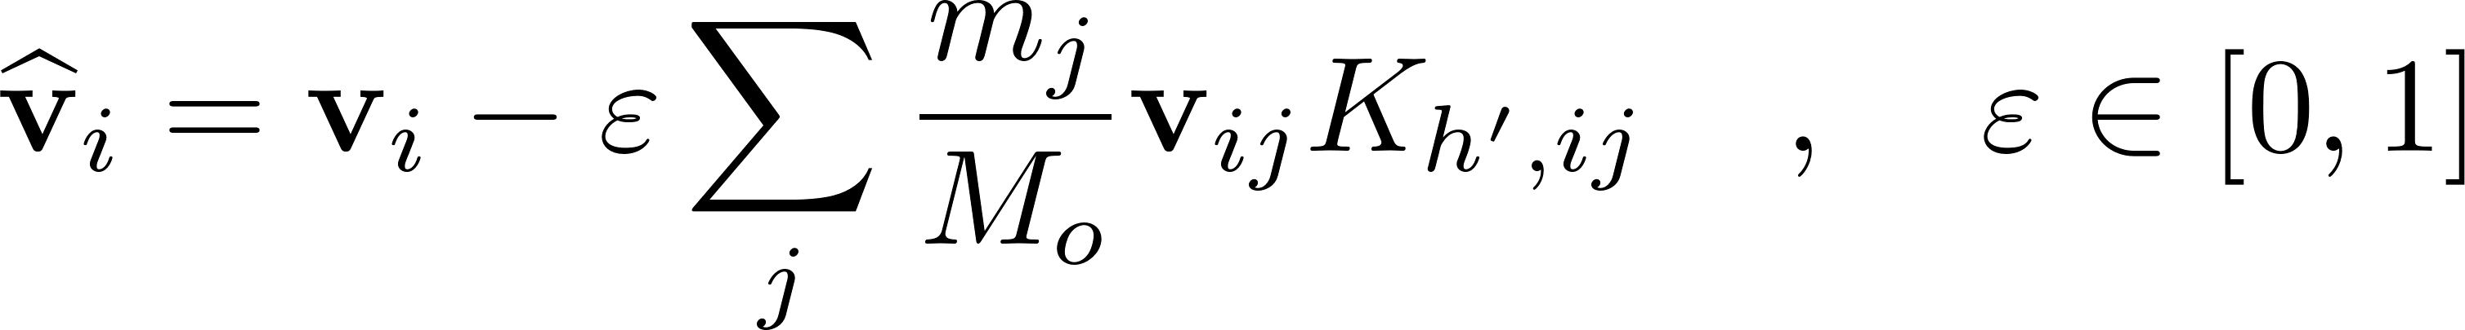
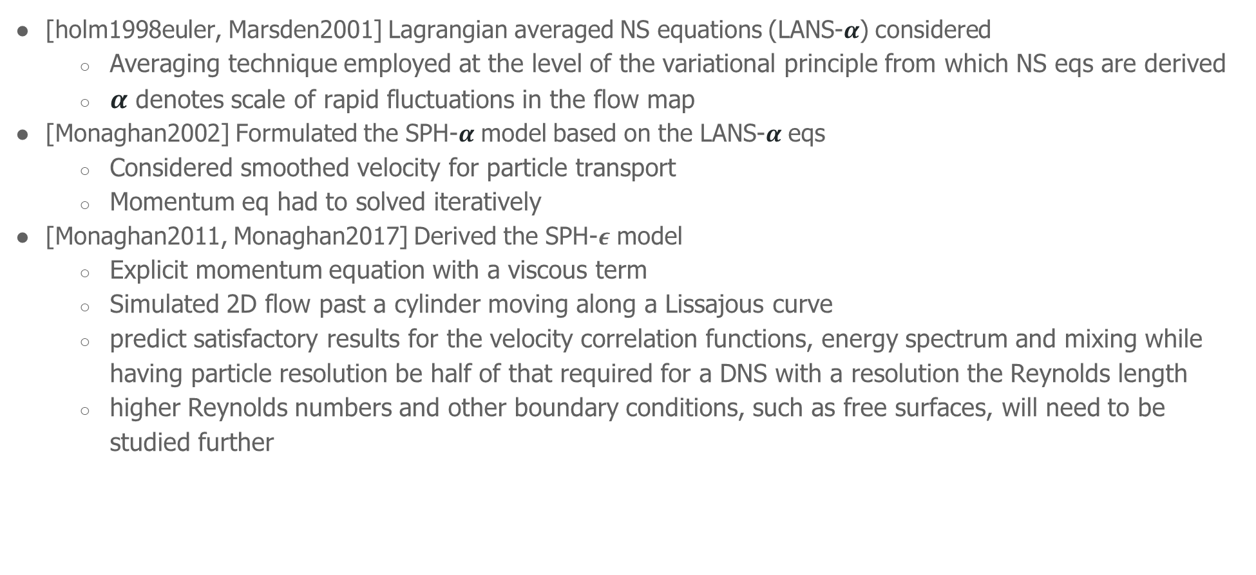
LANS-based Models
[holm1998euler, Marsden2001] Lagrangian averaged NS equations (LANS-$α$) considered
Averaging technique employed at the level of the variational principle from which NS eqs are derived
$α$ denotes scale of rapid fluctuations in the flow map
[Monaghan2002] Formulated the SPH-$α$ model based on the LANS-$α$ eqs
Considered smoothed velocity for particle transport
Momentum eq had to solved iteratively
[Monaghan2011, Monaghan2017] Derived the SPH-$ε$ model
Explicit momentum equation with a viscous term
Simulated 2D flow past a cylinder moving along a Lissajous curve
predict satisfactory results for the velocity correlation functions, energy spectrum and mixing while having particle resolution be half of that required for a DNS with a resolution the Reynolds length
higher Reynolds numbers and other boundary conditions, such as free surfaces, will need to be studied further
[1] Dynnikova, G. Ya et al. (2021). “Stability of a reverse Karman vortex street”. In: Physics of Fluids 33.2. ISSN: 10897666. DOI: 10.1063/5.0035575.

Slide 16
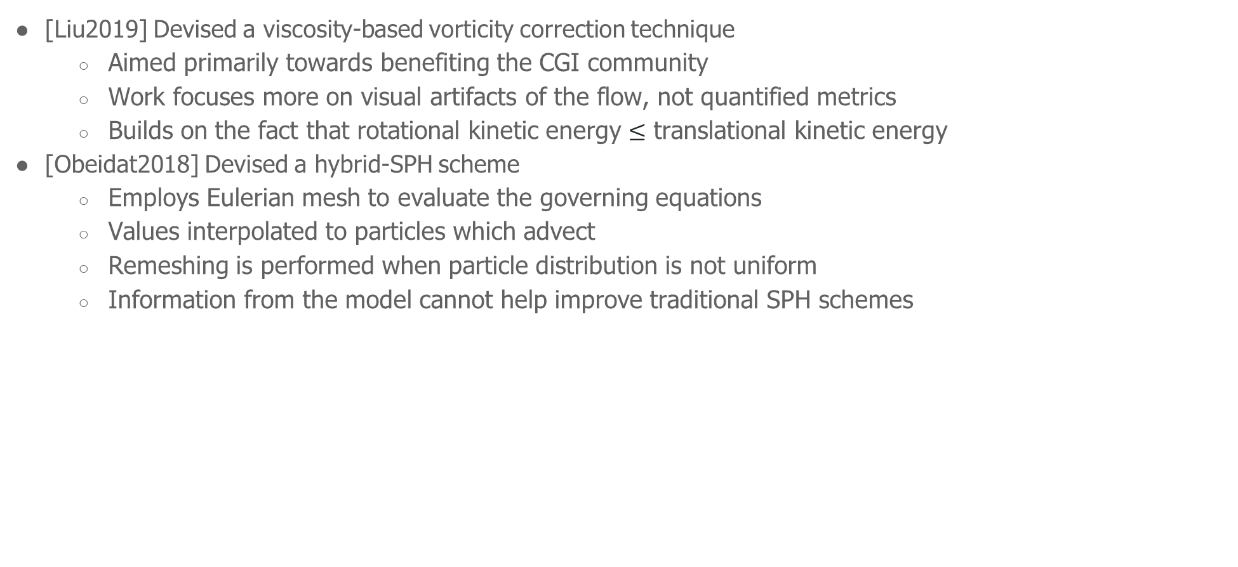
Miscellaneous Models
[Liu2019] Devised a viscosity-based vorticity correction technique
Aimed primarily towards benefiting the CGI community
Work focuses more on visual artifacts of the flow, not quantified metrics
Builds on the fact that rotational kinetic energy $≤$ translational kinetic energy
[Obeidat2018] Devised a hybrid-SPH scheme
Employs Eulerian mesh to evaluate the governing equations
Values interpolated to particles which advect
Remeshing is performed when particle distribution is not uniform
Information from the model cannot help improve traditional SPH schemes
[1] Dynnikova, G. Ya et al. (2021). “Stability of a reverse Karman vortex street”. In: Physics of Fluids 33.2. ISSN: 10897666. DOI: 10.1063/5.0035575.

Slide 17
Evaluation of Turbulence Models
Most of Lagrangian turbulent models seem to be tested for only complex surface flows
Systematic analysis of isotropic turbulence problems provides greater insight into the energy spectrum and its corresponding cascade across varying length scales.
Appropriate bounded/periodic test cases must be used when analyzing turbulence
Energy cascade might not always be apt? Use coherent structures, vorticity, other suitable metrics [Q]
[1] Dynnikova, G. Ya et al. (2021). “Stability of a reverse Karman vortex street”. In: Physics of Fluids 33.2. ISSN: 10897666. DOI: 10.1063/5.0035575.

Slide 18
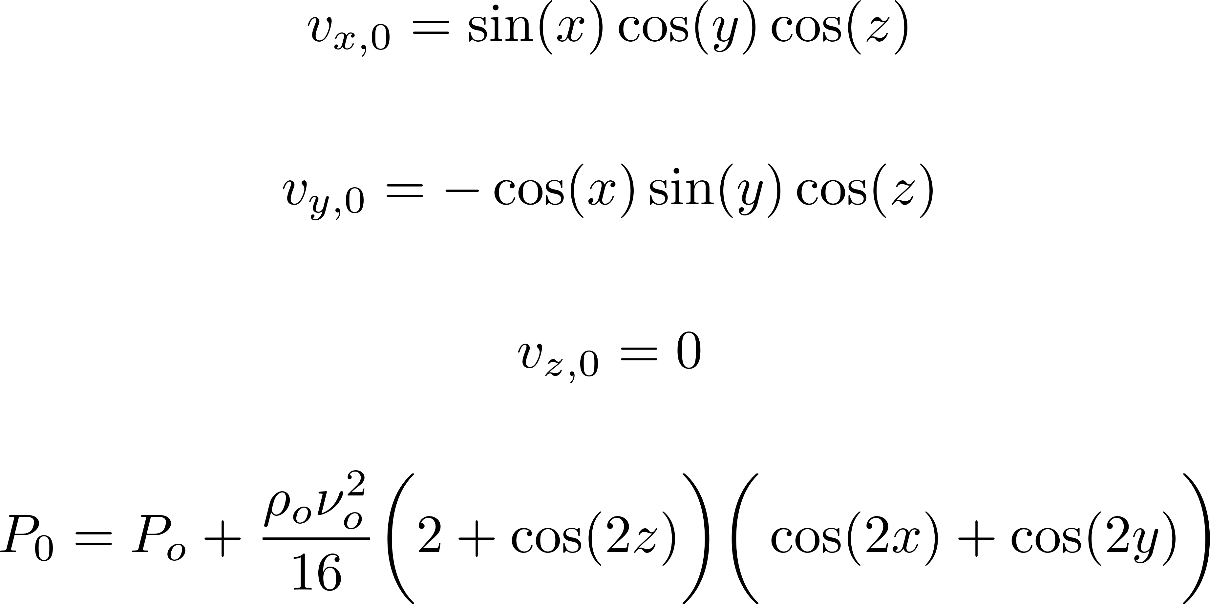
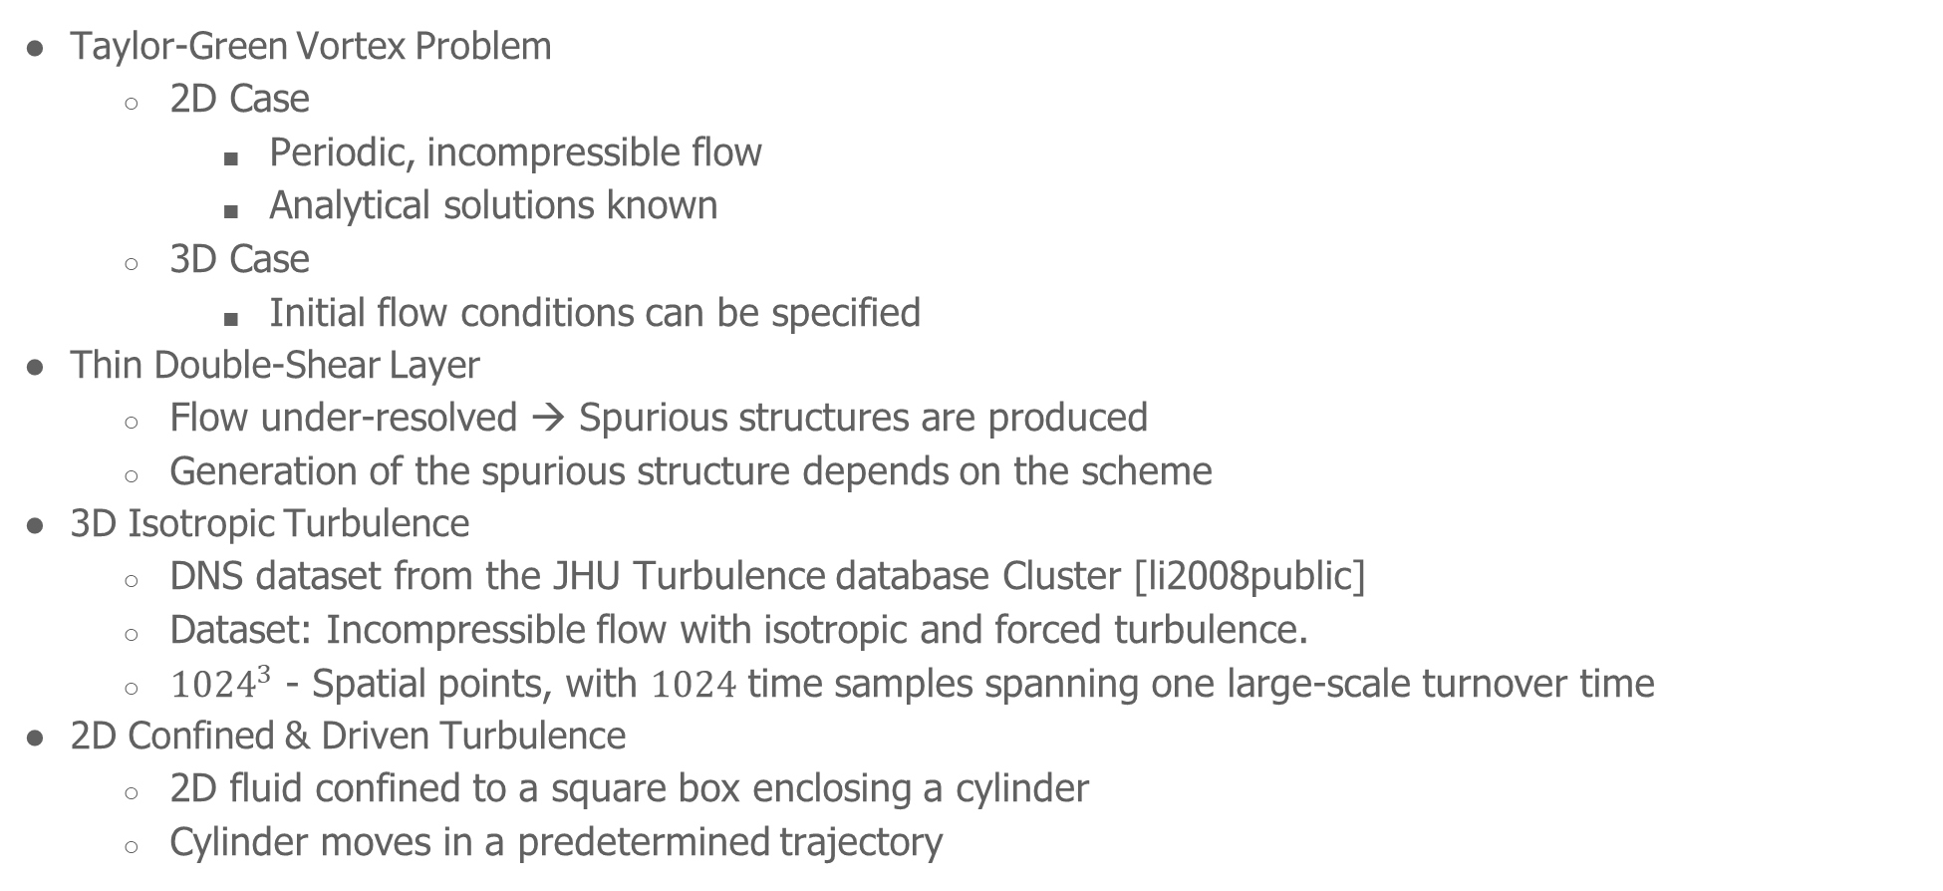
Benchmark Problems
Taylor-Green Vortex Problem
2D Case
Periodic, incompressible flow
Analytical solutions known
3D Case
Initial flow conditions can be specified
Thin Double-Shear Layer
Flow under-resolved → Spurious structures are produced
Generation of the spurious structure depends on the scheme
3D Isotropic Turbulence
DNS dataset from the JHU Turbulence database Cluster [li2008public]
Dataset: Incompressible flow with isotropic and forced turbulence.
${1024}^{3}$ - Spatial points, with $1024$ time samples spanning one large-scale turnover time
2D Confined & Driven Turbulence
2D fluid confined to a square box enclosing a cylinder
Cylinder moves in a predetermined trajectory
[1] Dynnikova, G. Ya et al. (2021). “Stability of a reverse Karman vortex street”. In: Physics of Fluids 33.2. ISSN: 10897666. DOI: 10.1063/5.0035575.

Slide 19
Post-Simulation Analysis
Energy spectral density
Velocity field over a grid generated using suitable interpolation of the particle velocity data [Shi2013]
Fourier transform of the velocity field performed → Velocity spectrum as a function of the wave-number
Energy spectrum computed from the velocity spectrum
Velocity gradient-based metrics
SPH formulations exist
some situations, most of the definitions of the vortex are not objective and suitable for studying the flow, particularly in the context of $3D$ flow. [haller2005]
Lagrangian coherent structures
Local velocity fluctuations do not induce noise
FTLE is formulated in the Lagrangian framework → Better identification of LCSs
SPH formulations available [sun2016]
Analysis flexibility:
backward-in-time FTLE can be computed using limited resources during run-time concurrently in this method. However, the forward-in-time FTLE can only be computed during post-processing.
Easily parallelizable
[1] Dynnikova, G. Ya et al. (2021). “Stability of a reverse Karman vortex street”. In: Physics of Fluids 33.2. ISSN: 10897666. DOI: 10.1063/5.0035575.

Slide 20
Conclusion & Future Work
[1] Dynnikova, G. Ya et al. (2021). “Stability of a reverse Karman vortex street”. In: Physics of Fluids 33.2. ISSN: 10897666. DOI: 10.1063/5.0035575.

Slide 21
Thank you!
Department of Aerospace Engineering
Indian Institute of Technology Bombay
October 25th, 2022

Slide 22
Blank Template Slides

Slide 23
[1] Dynnikova, G. Ya et al. (2021). “Stability of a reverse Karman vortex street”. In: Physics of Fluids 33.2. ISSN: 10897666. DOI: 10.1063/5.0035575.

Slide 25
Filled Template Slides

Slide 26
Project Motivation
Simulation Parameters
Reynolds number
Swimming trajectories
Single/Multi Swimmers
Placements & Configurations
Boundary Conditions
Geometry
And many more...
Study of Forces
Motion of Biological Swimmers
High-Fidelity - CFD Solvers
Study of Energetics
Develop underwater vehicles with:
better mobility
lower noise
higher endurance
efficiency
Low-Fidelity - Theoretical or Computational Frameworks
Project Outcome
Gain better understanding of the problem at hand
Utilizes lesser resources
Allows for faster iteration over models

Slide 27
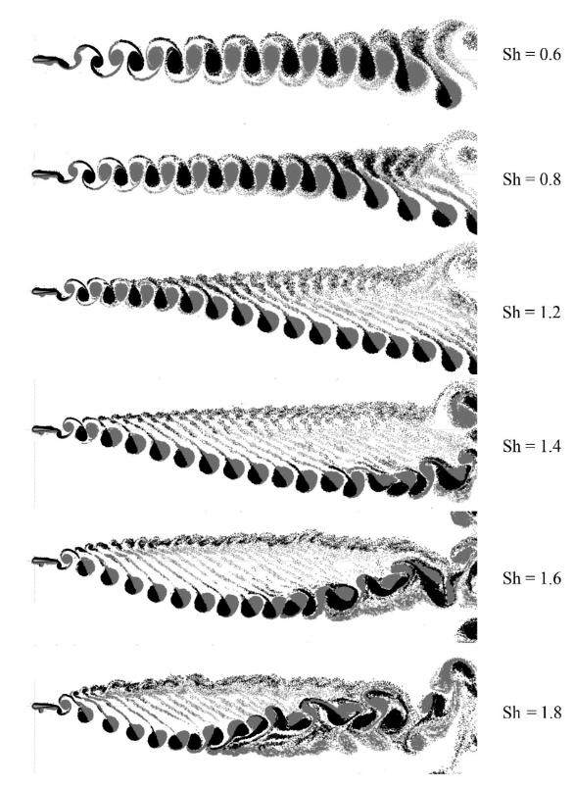
Conclusion
Thrust produced continuously → Output is not stable.
Sharp peaks in thrust production coincide with vortex shedding.
Airfoil starts its heaving motion with downwards stroke → Small negative lift is produced (average)
Airfoil starts its heaving motion with upwards stroke → Small positive lift is produced (average).
General trend in bulk movement of shed vortices as shown by Dynnikova^{[1]} is observed.
Fig: Vortex wakes behind an airfoil performing angular oscillations^{[7]}
[1] Dynnikova, G. Ya et al. (2021). “Stability of a reverse Karman vortex street”. In: Physics of Fluids 33.2. ISSN: 10897666. DOI: 10.1063/5.0035575.

